Slide 1
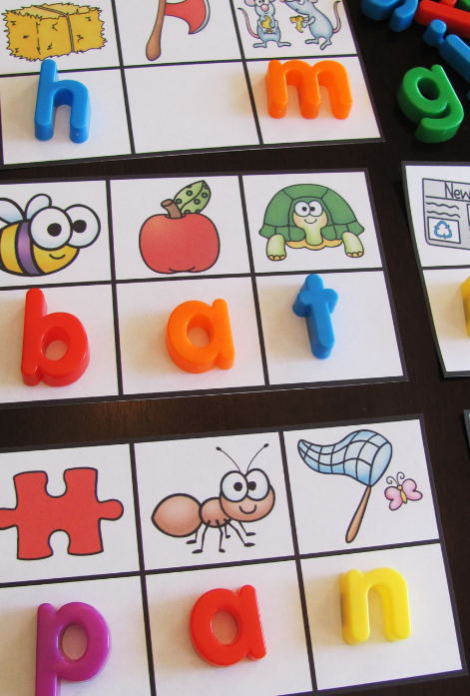
Learning to Read Reading and Phonics for Parents and Carers

Slide 2
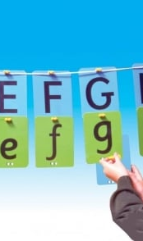
Aims
To understand what Phonics is and how children learn to read.
To understand the importance of Phonics.
To understand the purpose of Phonics.
To understand the terminology involved.
To understand the expectations and progression in Phonics.

Slide 3
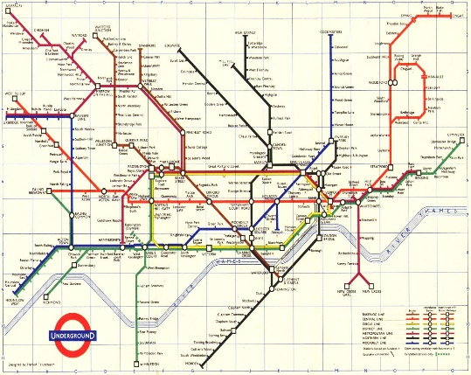
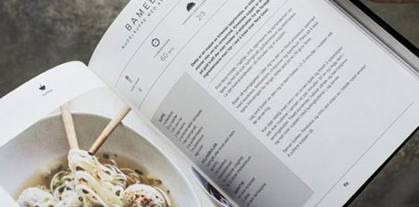
Think about yourself reading. What skills do you need, what do you need to know?
This Photo by Unknown Author is licensed under CC BY-SA

Slide 4
How do children learn to read?
The reading process begins from birth.
By the age of 1 year, babies begin to link words to meaning.
At about 18 months, children can add new words to their vocabulary at the astounding rate of one every 2 hours.
By age 2, most children have around 50-200 words and combine two words to form simple sentences such as: "Go out." "All gone."
Between 24 to 30 months, children speak in longer sentences.
From 30 to 36 months, children begin following the rules for expressing tense and number and use words such as some, would, and who.
Children aged 3 years old will be using sentences of around 7 to 9 words.
Notes:
Read first - Emerging literacy begins in infancy as a parent lifts a baby, looks into her eyes, and speaks softly to her. It's hard to believe that this casual, spontaneous activity is leading to the development of language skills. This interaction helps the baby learn about the give and take of conversation and the pleasures of communicating with other people.
To find out more up to date information on this, look the The Literacy Trust.

Slide 5
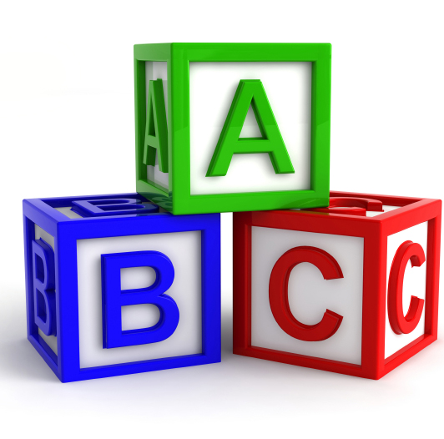
How do children learn to read? Reading and Writing
At the same time as they are gaining listening and speaking skills, young children are learning about reading and writing.
They listen to favourite stories and retell them on their own, play with alphabet blocks, point out the logo on a sign for a favourite restaurant, draw pictures, scribble and write letters and words, and watch as adults read and write for pleasure and to get jobs done.

Slide 6
What skills do readers and writers need?
Know print carries meaning by:
Turning pages in a storybook to find out what happens next
"writináág" (scribbling or using invented spelling) to communicate a message
Using the language and voice of stories when narrating their stories
Dictating stories
Know what written language looks like by:
Recognizing that words are combinations of letters
Identifying specific letters in unfamiliar words
Writing with "mock" letters or writing that includes features of real letters
Can identify and name letters of the alphabet by:
Saying the alphabet
Pointing out letters of the alphabet in their own names and in written texts
Know that letters are associated with sounds by:
Finger pointing while reading or being read to
Spelling words phonetically, relating letters to the sounds they hear in the word
Notes:
By the time chn start school in reception, chn will be able to do all of this. This makes them ready for reception and learning to read and write.
Because children have been learning language since birth, most are ready to move to the next step – mastering conventional reading and writing.

Slide 7
Know the sounds that letters make by:
Naming all the objects in a room that begin with the same letter
Pointing to words in a text that begin with the same letter
Picking out words that rhyme
Trying to sound out new or unfamiliar words while reading out loud
Representing words in writing by their first sound (e.g., writing d to represent the word dog)
Know using words can serve various purposes by:
Pointing to signs for specific places, such as a play area, a restaurant, or a store
Writing for different purposes, such as writing a (pretend) grocery list, writing a thank-you letter, or writing a menu for play
Know how books work by:
Holding the book right side up
Turning pages one at a time
Reading from left to right and top to bottom
Beginning reading at the front and moving sequentially to the back

Slide 8
How do children learn to read? Becoming readers and writers
To become effective readers and writers children need to:
Recognise the written symbols letters and words used in reading and writing
Write letters and form words by following conventional rules
Use routine skills and thinking and reasoning abilities to create meaning while reading and writing
Notes:
Read slide
This is where Phonics comes into play

Slide 9
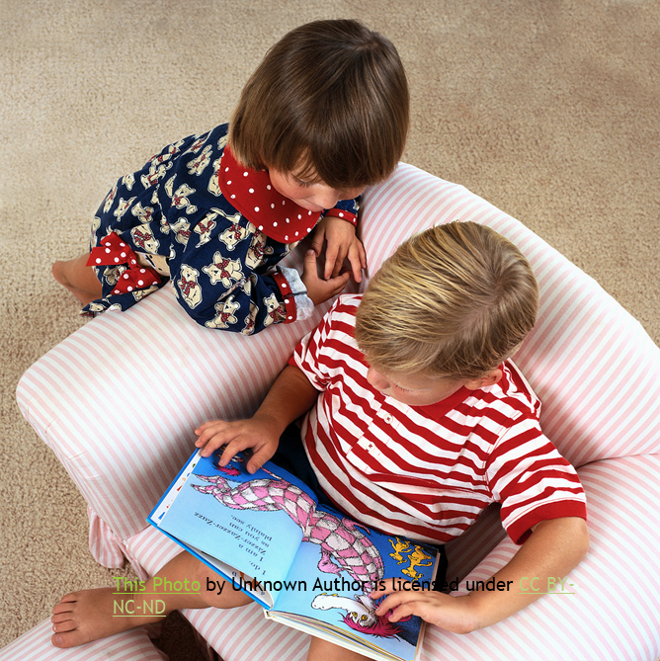
Learning to read is important BUT Learning to read is HARD!
Notes:
Read slide!
Reading is a high priority at … and we spend lots of time trying to make this process as easy as possible for our children.
Learning to read is very challenging! It’s like us now, trying to learn another language, we will make lots of mistakes, we will find it hard and it will take time and practise! But the only way we will become fluent is to keep practising, even when learning becomes challenging.
Little and often is the key!
It also needs to be fun, interactive and enjoyable for the children.

Slide 10
Notes:
Example Building Blocks – Before I Read
Developed and used as a tool by Stockport Early Yeas Team

Slide 11
Importance of Phonics!
One in six 11 year olds still struggle to read.
One in 10 boys aged 11 read no better than a seven year old.
England has slipped behind other nations in reading.
GCSE pupils' reading is more than a year behind the standard of their peers in Shanghai, Korea and Finland.
Poor reading skills in children has been linked to challenging behaviour, disengaged learners, exclusions, and low confidence.
This decline is reflected in the skills of England’s workforce. Employers report that young people often lack the basic literacy skills to work effectively. The absence of these valued skills appears to have a direct impact on the high levels of youth unemployment.
If children do not learn to read,
they cannot read to learn!
Notes:
If you have a look through this slide you will read some of the key facts and reasons that Phonics and Reading is a high priority area for schools and it’s importance in every child’s life.
Focus on the last bullet point.
Phonics is about preparing children for real life!

Slide 12
What is Phonics?
“Phonics is a way of teaching children to read quickly and skilfully. They are taught how to:
Recognise the sounds that each individual letter makes;
Identify the sounds that different combinations of letters make; and
Blend these sounds together from left to right to make a word.
Children can then use this knowledge to ‘de-code’ new words that they hear or see.
This is the first important step in learning to read.”
(Department for Education, 2013)
Notes:
Read slide

Slide 13
So what is the purpose of Phonics?
“Research shows that when phonics is taught in a structured way – starting with the easiest sounds and progressing through to the most complex – it is the most effective way of teaching young children to read.
Almost all children who receive good teaching of phonics will learn the skills they need to tackle new words. They can then go on to read any kind of text fluently and confidently, and read for enjoyment.
Children who have been taught phonics also tend to read more accurately than those taught using other methods, such as ‘look and say’.
This includes children who find learning to read difficult, for example those who have dyslexia or SEND.”
(Department for Education, 2013)
This Photo by Unknown Author is licensed under CC BY-NC-ND
Notes:
Many of us will not have been taught to read using Phonics and there are more ways that you can learn to read, however…
Read slide – So what is the purpose of Phonics?

Slide 14
Why Phonics?
Phonics also helps children to develop their speech and articulation of sounds.
Phonics helps children develop a love of reading.
Phonics helps children learn to spell.
Phonics increases fluency in reading.
Phonics helps children extend their vocabulary.
Notes:
Read slide first
Phonics makes reading easier and gives the child a support system to use to read.
A support system they can use independently without an adult.
If a child can decode a text easily and independently, they are more likely to enjoy reading and choose to read for fun (given access to engaging texts).

Slide 15
Terminology Phonemes and graphemes
phoneme
smallest unit of sound in a word
grapheme
letter or sequence of
letters that represents
a phoneme

Slide 16
Terminology Blending and Segmentation
Blending
Merging the individual phonemes together to pronounce a word.
To read unfamiliar words a child must recognise (sound out) each grapheme, not each letter, then merge the phonemes together to make a word.
Segmentation
Hear and say the individual phonemes within words.
In order to spell, children need to segment a word into its component phonemes and choose a grapheme to represent each phoneme.

Slide 17
Some definitions
Digraph
Two letters, which make one phoneme.
A consonant digraph contains 2 consonants:
sh ck th ll
A vowel digraph contains at least one vowel:
ai ee ar oy
Trigraph
Three letters which make one phoneme
igh ear ure air tch eau

Slide 18
What does effective Phonics teaching and learning look like?
Multi-sensory
Engaging
Fun
Snappy
Appropriate
Opportunities to practice blend and segment sounds
Interactive
Notes:
So back to…

Slide 19
Phases and Progression
Phase 1
Explore and experiment with sounds. Distinguish between sounds in the environment.
Phase 2
Learn 19 phonemes and know the graphemes that represent them. Begin to segment CVC words (e.g. Cat)
Phase 3
Teach another 25 phonemes and graphemes. Continue to segment and blend longer words (e.g. rain)
Phase 4
To consolidate children’s knowledge of graphemes in reading and spelling words.
Phase 5
Children broaden their knowledge of graphemes and phonemes for use in reading and spelling and spelling alternative graphemes. 13 new graphemes, 5 split diagraphs, 13 new pronunciations.
Phase 6
SPAG – Learn some of the rarer phoneme/grapheme correspondences. Learning simple spelling rules and grammar e.g. Plurals..
Notes:
There are many different schemes to follow and each school will have their own way, but at … (we follow Letters and Sounds which is a government scheme) .
L&S is broken down into six phases as you can see in the slide.
Phase 1 is usually taught in Nursery.
Phase 2-4 in Reception
Phase 5 in Year 1
Phase 6 in Year 2
The bulk of the learning takes place in nursery and Reception
This is where they learn to read words. Years 1 and 2 build on this and Year 2 is mainly about fluency of longer texts and spelling, grammar and punctuation.

Slide 20
Phase 1 - Nursery
There are 7 aspects within Phase 1 Letters and Sounds.
Aspect 1 – Environmental
Aspect 2 – Instrumental sounds
Aspect 3 – Body Percussion
Aspect 4 – Rhythm and rhyme
Aspect 5 – Alliteration
Aspect 6 – Voice sounds
Aspect 7 – Oral blending and segmenting.
Notes:
3 strands are Aspects 1 -3 non voiced -
Aspect 3-5 voiced
Aspect 7 sounds within words
If children are struggling with phonics in Reception and Year 1, even Year 2 or higher. It may be likely that they have gaps in their Phase 1 knowledge.
For example, if your child is struggling to;
Remember initial sounds when sounding out a word to read.
Forgotten what they read first by the time they get to the end of a sentence.
Cannot hear the sounds in sounds in words.
Struggles to recognise letter shapes by sight and match them to a sound.
Struggles to discriminate between different sounds and letter shapes.

Slide 21
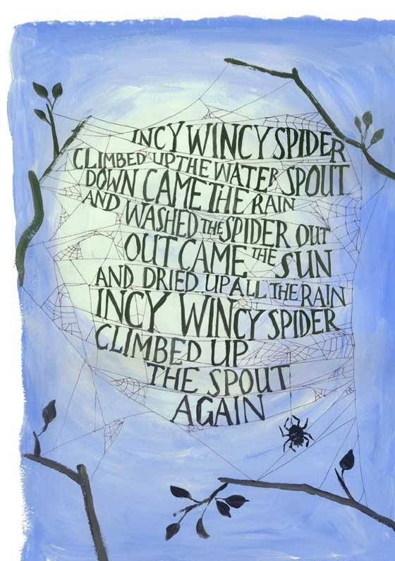
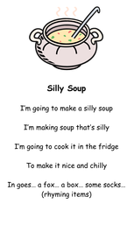
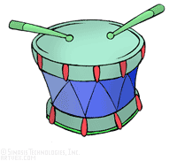
Some Phase 1 activities
This Photo by Unknown Author is licensed under CC BY-SA-NC
Notes:
Emphasis on oral sounds (phonemes)
Play Silly Soup
Environmental sounds – aeroplanes, church bells, traffic, emergency vehicles, birdsong.
Importance of nursery rhymes
Musical instruments, - make own instruments doesn’t have to be expensive

Slide 22
Phase 2 - Reception
In Phase 2 children learn their first set of graphemes (letters)
s, a, t, p
i, n, m, d
g, o, c, k
ck, e, u, r
h, b, f, ff, l, ll, ss
Notes:
In Phase 2, children begin to learn their first set of graphemes. These two Year 2 children are going to very kindly articulate the graphemes to show you how they are said correctly. You will notice that we focus on the sounds that these graphemes make, not the letter names. You will also notice that the children learn these sounds as pure sounds. This means that you don’t hear the swcha sound on the end of them, for example, we say s not sah!

Slide 23
Phase 3 - Reception
j, v, w, x
y, z, zz, qu
Consonant digraphs: ch, sh, th, ng
Vowel digraphs: ai, ee, igh, oa, oo, ar, or, ur, ow, oi, ear, air, ure, er
Notes:
More new graphemes continue into phase 3
This is when they start to get a bit harder. Children start to explore digraphs and trigraphs which is when two or three letter shapes make one sound.

Slide 24
Phase 4 - Reception
No new phonemes or graphemes
This phase consolidates what the children have learnt in the previous phases.
Notes:
In Phase 4, no new graphemes are introduced. (about 4 weeks)
Usually end of Reception/beginning of Year 1. This is a consolidation phase when children learn to use and apply all the sounds they have learnt for reading and spelling. They also look at more complex word structures like two syllable words. Important for extending vocabulary.

Slide 25
Phase 5 – Year 1
Children will be taught new graphemes and alternative pronunciations for these graphemes.
Vowel digraphs: wh, ph, ay, ou, ie, ea, oy, ir, ue, aw, ew, oe, au
Split digraphs: a_e, e_e, i_e, o_e, u_e
Notes:
As your child moves into Phase 5, they begin to learn the last set of graphemes. Again these before more complex and include split-diagraphs which is when a grapheme is split within a word – we refer to the e on the end as the magic e. Chn also learn alternative pronunciations.

Slide 26
Phase 6 – Year 2
The focus is on learning spelling rules for suffixes as well as other spelling patterns and rules.
-s -es -ing -ed
-er -est -y -en
-ful -ly -ment -ness
Notes:
Phase 6 is all about spelling patterns and grammar. For example, these are some of the things they learn about.

Slide 27
Articulation of Sounds
Notes:
In Phonics we say each phoneme as a pure sound. That means we don’t put the ‘uh’ sound on the end of phonemes like ‘muh’, it is mmmmmmmmm.
This is how we say each of the other phonemes.
This articulation is important because when children learn to blend to read, the sounds are clearer which helps them hear the words better.

Slide 28
Phoneme / Grapheme Correspondence
Hear it, say it
See it, say it
Say it and write it
Notes:
In a phonics session, children will spend time listening to the sound and saying it correctly before they are introduced to the grapheme.
The teacher will talk about how to move your mouth to form the sound correctly, for example, where you put your tongue, lips etc
For example, if you make the mmm sound, you put your lips together. Try it.
Then the children will look at the grapheme and talk about the letter shapes.
Flashcards can be useful which you can get from amazon if you wanted some for home.
They have the grapheme, a picture and a ditty that helps the children remember it and form the letter.
The children learn to form the letter too at the point – dough disco, squiggle whilst you wiggle – see later
In Reception there are also songs and actions for the phase 2 sounds – Some schools use the jolly phonics ditties/songs which can be found on you tube

Slide 29
Blending
Building words from phonemes to read.
c a t
cat
Notes:
Then the children learn to read words. Blending is sounding out each letter and then putting the sounds together. For example c a t cat.
Children use actions –
For children struggling to hear all sounds
Sound buttons – are used to help chn identify all the phonemes, very helpful as the words get larger and we start introducing digraphs and trigraphs.

Slide 30
Blending
qu ee n
queen
Notes:
Here is another example. So you can see we are moving onto Phase 3 digraphs which is when 2 letters make one sound. The button then becomes a line.
Model with actions
You can graft too - model

Slide 31
Segmenting
Breaking down words for spelling.
cat
c a t
Notes:
Alongside blending to read – chn learn to segment to spell – both equally important
Read slide – segmenting is…
Y

Slide 32
Segmenting
queen
qu ee n
Notes:
And again.
Children will practise spelling these words as well as reading.

Slide 33
What does a Phonics lesson look like?
Revisit/review | Flashcards to practice phonemes learnt so far.
Teach | Teach new phoneme, blending, segmenting, tricky word,
Practice | Games and activities related to the new phoneme.
Apply | Read captions/sentences Apply in independent work.
Notes:
Choose here whether to model part of a lesson or show a good quality video clip. Miss …. is going to model some of the features of a phonics lesson at … but first we will just have a quick look at the structure of a lesson.
Read slide
If this session takes place during the day, invite some children to join so that parents can look at the activities.
Use a multi-sensory approach and keeping everything as practical, physical and fun as possible.
Consider inviting some parents in to a join a lesson.

Slide 34
What can you do at home?
Talk to your child as much as possible!
To build their vocabulary
To build their understanding of language
To help children make choices and decisions independently
To help children express emotions and talk about emotions
To help children socially interact
To recall experiences
To problem solve
To take on different roles
To develop empathy
To express ideas and imagination
Notes:
Although children learn the fundamental skills of learning to read at school. It is important that children practise these skills all the time, not just in school hours as this is not enough to allow a child to make good progress in their reading and writing.

Slide 35
What can you do at home?
Develop a talk-rich environment!
High quality modelling of language from adults – including using specific language
Use the correct names for household items, animals, etc.
Different spaces and places for different kinds of talk
Take time to explore nature and the outdoors together
Point out familiar print in the environment, such as when shopping
Find out the meaning of unknown words
Sing nursery rhymes and make up own rhymes
Prioritise Bedtime stories (routines such as Bathtime and Bed time story)
Introduce high-quality texts that bring new vocabulary and language structures.
Build up a small home library/collections of favourite stories, books and rhymes
Make homemade books and photograph albums, scrapbooks
Join the local library
Notes:
Although children learn the fundamental skills of learning to read at school. It is important that children practise these skills all the time, not just in school hours as this is not enough to allow a child to make good progress in their reading and writing.
Good language skills put a child on the path to becoming a fluent reader

Slide 36
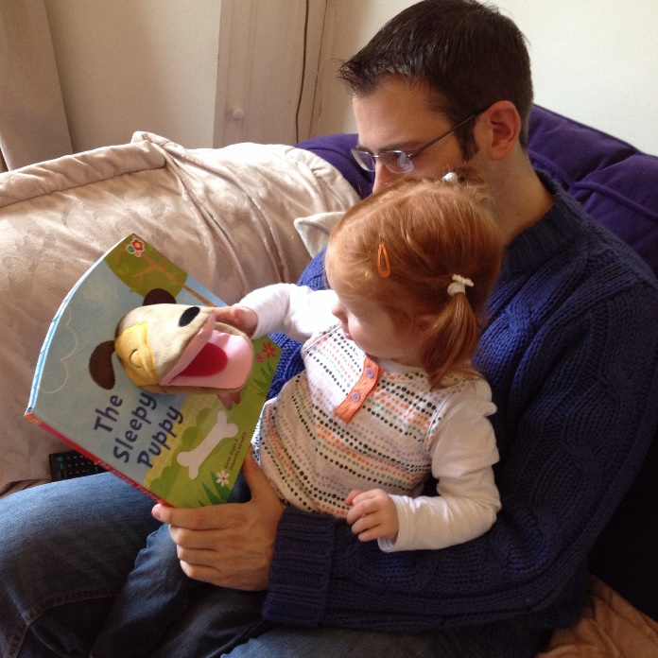
What can you do at home?
For children with SEND
Recapping sounds can aid speech development
Little and more often
More repetition
Emphasis on voice sounds rhyme, action words and repetition
Multi sensory approach!
Use hand gestures and facial expression, Makaton signs and symbols
Don’t try and move on too quickly – focus on one thing at a time
Notes:
Read at home – even if just for a few minutes
There are also many games you can play. Set up around the room up with activities for parents and children to play together. .

Slide 37
Further Ideas to support literacy at home
Make models or small worlds of favourite stories
Collect role play props and dressing up clothes
Play with puppets or make your own
Make a scrap book or journal of days out, photo albums of special events, pictures of family members
Listen to story tapes (get grandparents, relatives, older children to record some favourite stories or rhymes)
Make paper dolls, cut out characters to make small plays
Make a shopping list
Follow a simple recipe to make biscuits or instructions to plant seeds etc.
Go on a treasure hunt in the environment (reading and writing clues)
Lotto games, word puzzles and jigsaws and I spy games
Share comics, look at catalogues
Cut out pictures from magazines and catalogues
Go on an environmental print hunt, look out for familiar icons and words on walks and journeys
Find out about animals, dinosaurs or space in non fiction books or on the internet

Slide 38
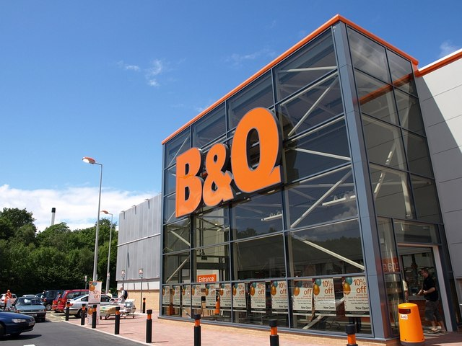
Notes:
Examples of environmental print.
What others can you think of
What are your children likely to see near where you live?
Which are they familiar with already?

Slide 39
10 Minutes a day!
Notes:
https://youtu.be/Orb6xXPPBKo
Importance of reading

Slide 40
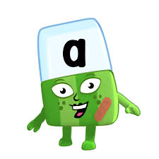
Phonics Play www.phonicsplay.co.uk Phonics Bloom www.phonicsbloom.com Reading Eggs www.readingeggs.co.uk Alphablocks - CBeebies www.bbc.co.uk/cbeebies/shows/alphablocks
Phonics Games to Play at Home (Apps)

Slide 41
Useful resources and Information on the web:
Tiny Happy People https://www.bbc.co.uk/tiny-happy-people
The Book Trust website www.booktrust.org.uk
Notes:
Tiny Happy People - BBC website to support parents to interact with their children. Type in ages of children for lots of ideas and activities

